Slide 1
Food Demand Forecasting
Presented By:
Oishi Saha
Santhoshi Priya
Sivani Papini
Anniket Jain
V. Sushant
Notes:
Oishi

Slide 2
A forecasting system to predict the upcoming demand for procurement and production planning in a food company

Slide 3
Predictive analytics techniques in order to decrease the costs and increase their productivity and profit.
Reduce overstocking and out-of-stock problems
Overstocking can lead to increased storage, labor, and insurance costs, as well as quality reduction and degradation depending on the type of the product.
Out-of-stock products can result in loss of sales, reduced customer satisfaction, and store loyalty.
BUSINESS UNDERSTANDING

Slide 4
Solution Workflow

Slide 5
Data Preprocessing
Modelling
Deployment
Data Understanding and Analysis
Result comparison

Slide 6
Data Preprocessing
Notes:
Sushant

Slide 7
The Food Demand Dataset had 3 schemas in raw form:
Fullfilment_center_info
Meal_info
Main Dataset
We combined the 3 schemas into one main dataset by joining them on their respective primary keys, center_id and meal_id.
We extracted a portion of the dataset by grouping it on the basis of weeks and center_id, and then calculated the sum and mean of the num_orders and base_price respectively.
Notes:
There were 3 schemas present in the raw form of food demand dataset.
Centre info and meal info had centre id and the meal id respectively as primary keys.
Both of the data was merged into the main dataset where these were the foreign keys.
A portion of the dataset was extracted by grouping it on the basis of weeks and center_id, and then calculating the sum and mean of the num_orders and base_price respectively.
All of this has been done for bringing in correlation with more kinds of features.

Slide 8
We performed dummy encoding on the categorical column (center_id) of the extracted dataset.
We split the dataset into train (70%), validation (20%) and test (10%) sets week wise, keeping in mind that we are to predict for the future data.
We applied Robust Scaling on the number of orders and base price feature column.
And finally, we extracted all the numerical features from the dataset, and split the train, validation and test sets into X_train and y_train etc. for modelling.
Notes:
Here are some more steps followed in data preprocessing stage namely..
Dummy encoding of the categorical columns, robust scaling for scaling the data according to the quantile range, splitting dataset into 70:20:10 for training, validation and testing respectively ,etc.

Slide 9
Data Understanding and Analysis
Notes:
Sushant

Slide 10
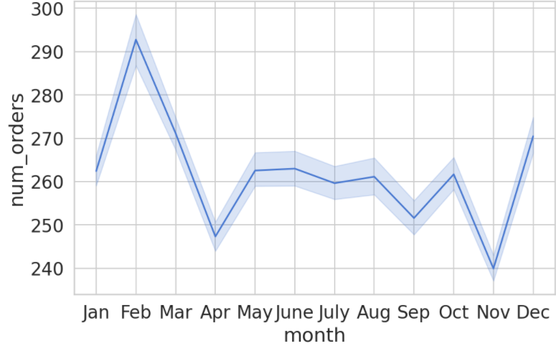
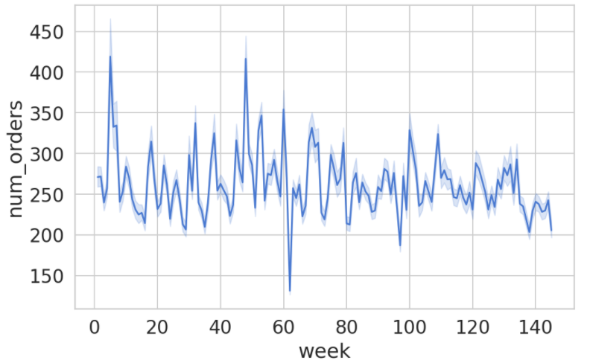
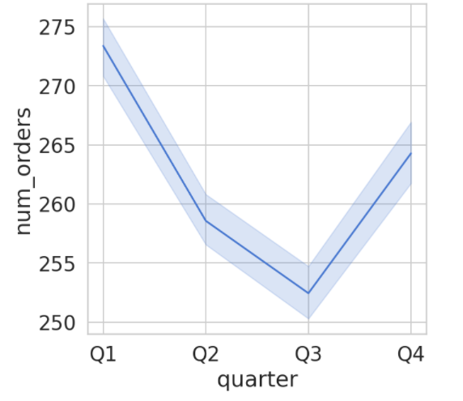
We plotted the weekly, monthly and quarterly trend of the data to understand the spread of the data
Notes:
Here are some visualisations consisting of weekly, monthly and quarterly trends of the mean number of orders.

Slide 11
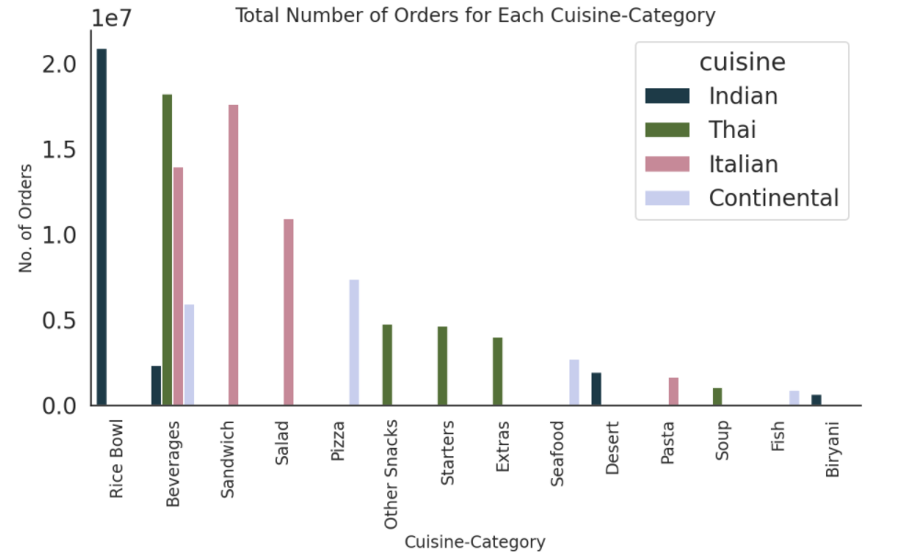
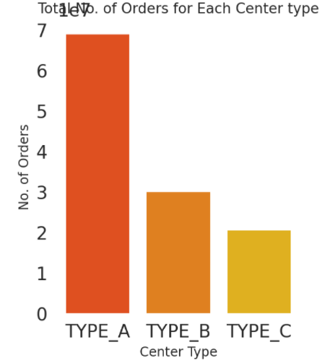
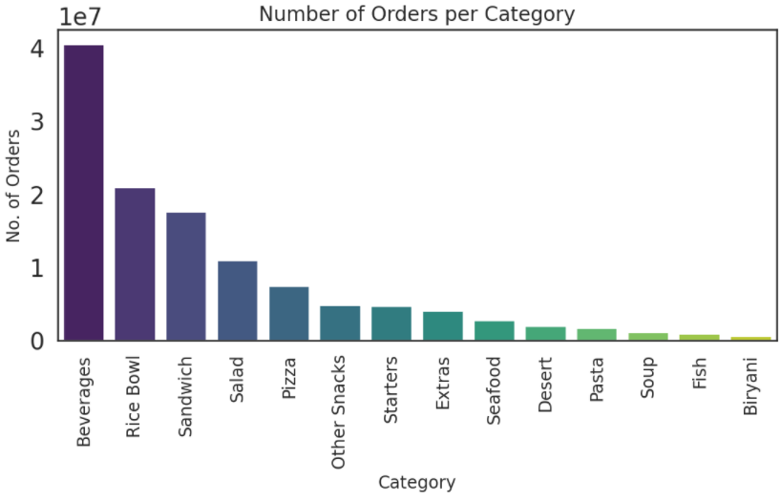
Plots to understand how different features affect our train set
Notes:
We have also explored other factors such as cuisine vs orders, center type vs orders, orders per category, etc.

Slide 12
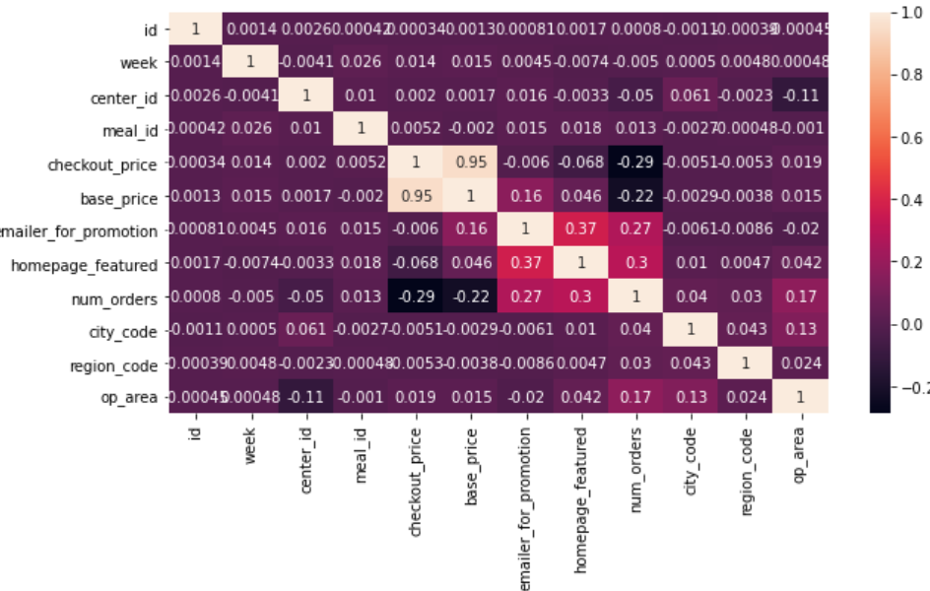
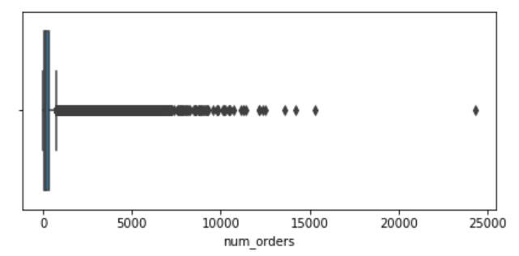
Correlations
Box Plot
Number of Upper Outliers : 10549
Number of Lower Outliers : 0
Percentage of Outliers : 2.973333295752099
Notes:
The correlation matrix shows how well correlated all the features are with each other. From this correlation matrix, we can find that two features, namely homepage featured and emailer for promotion are highly correlated with the target column that’s the number of orders.
We also see the box plot on the right, it is a standardized way of displaying the distribution of data. We can observe that to there exist many scattered upper outliers than, but no lower outliers.

Slide 13
Modelling
Notes:
Sivani

Slide 14
We implemented GRU, LSTM and ANN.
The performance metric that we primarily used for evaluating our model’s performance was mean square error and R-square error.
We used the Adam optimizer for all of our models with learning rates 0.001 .
Implemented early stopping and trained the models for 100 epochs.

Slide 15
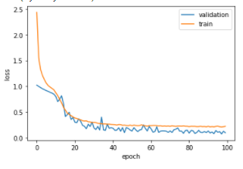
Model 1: GRU
The GRU model has 2 GRU layers, 2 Dense layers in its architecture. 4 Dropout layers with 30% dropout rate were added to increase the robustness of the model. Batch Normalization layers were also added to allow the model to converge more quickly.

Slide 16
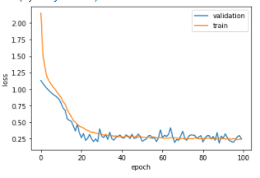
Model 2: LSTM
The LSTM model implemented has 2 LSTM layers, 2 Dense layers in its architecture. 4 Dropout layers with 30% dropout rate were added to increase the robustness of the model. Batch Normalization layers were also added to allow the model to converge more quickly.

Slide 17
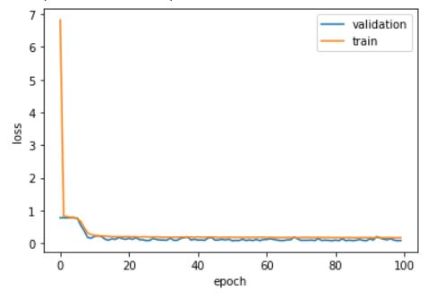
Model 3: ANN
The ANN model implemented has 5 Dense layers in its architecture. 2 Dropout layers with 30% dropout rate were added to increase the robustness of the model. This model was used as a baseline model.

Slide 18
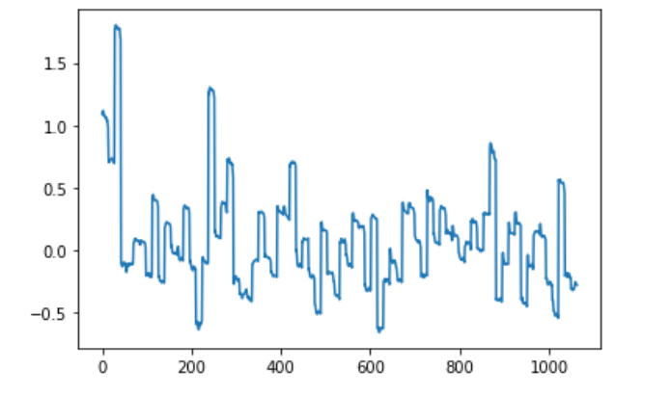
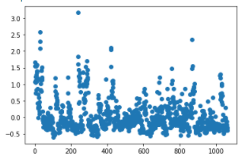
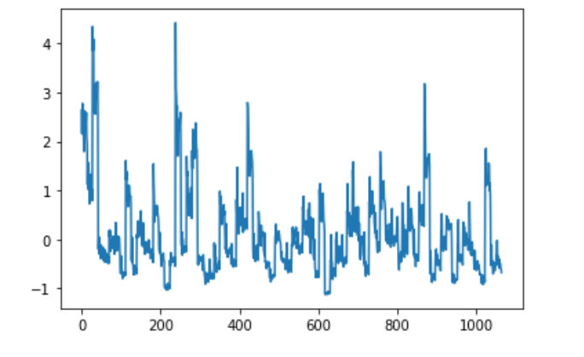
Results
Predicted Vs Ground Truth for Test Set (LSTM)
Error Scatter Plot
Notes:
Priya

Slide 19
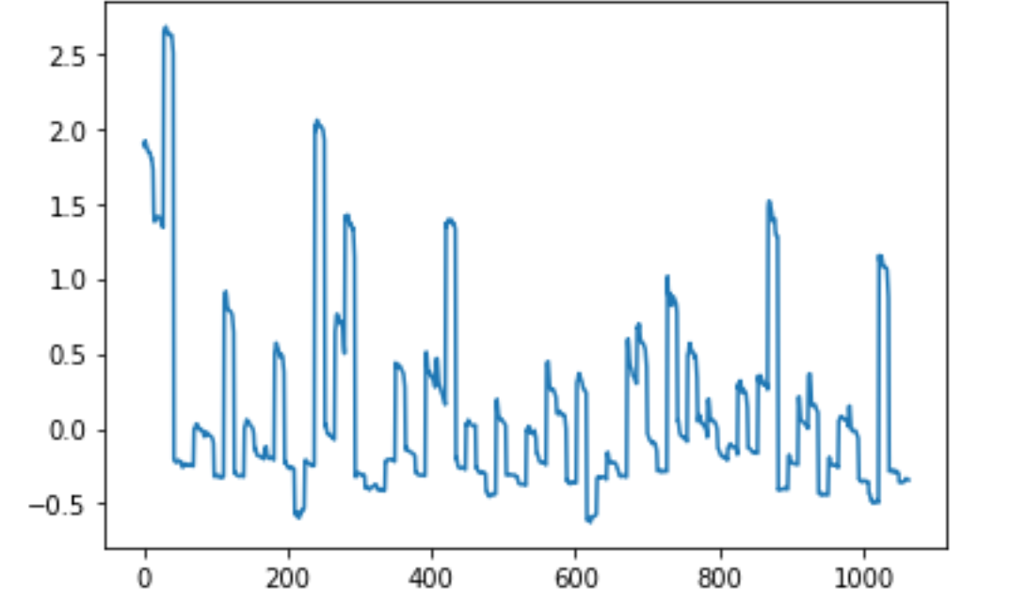
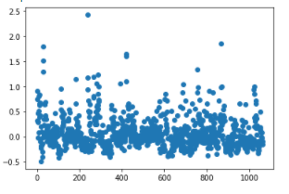
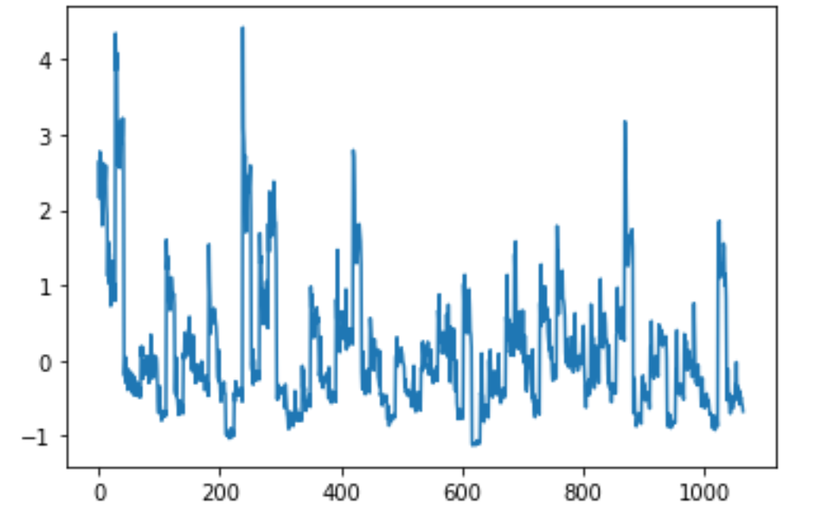
Predicted Vs Ground Truth for Test Set (GRU)
Error Scatter Plot

Slide 20
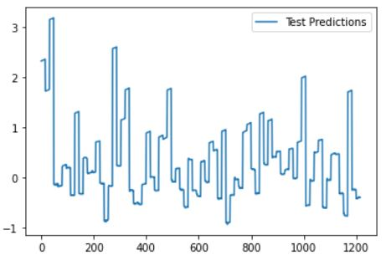
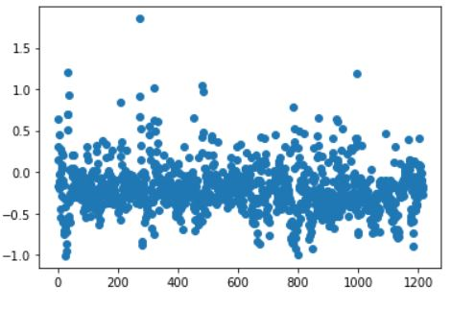
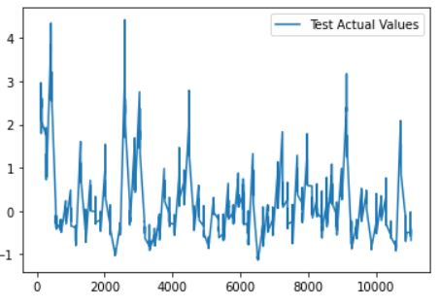
Predicted Vs Ground Truth for Test Set ANN
Error Scatter Plot
Notes:
Priya

Slide 21
Model Comparison
Evaluation metrics used :
R- squared score
Mean Squared Error
MODELS | R2 | MSE
ANN | 0.885 | 0.0864
LSTM | 0.778 | 0.159
GRU | 0.800 | 0.142

Slide 22
Conclusion

Slide 23
We built 3 models : GRU, LSTM and ANN .
ANN gave best results among the 3 models
GRU outperforms LSTM, because :
LSTM is more accurate on dataset using longer sequence.
And our dataset has relatively shorter sequences, therefore GRU performs better.

Slide 24
Deployment
Notes:
Anniket

Slide 25
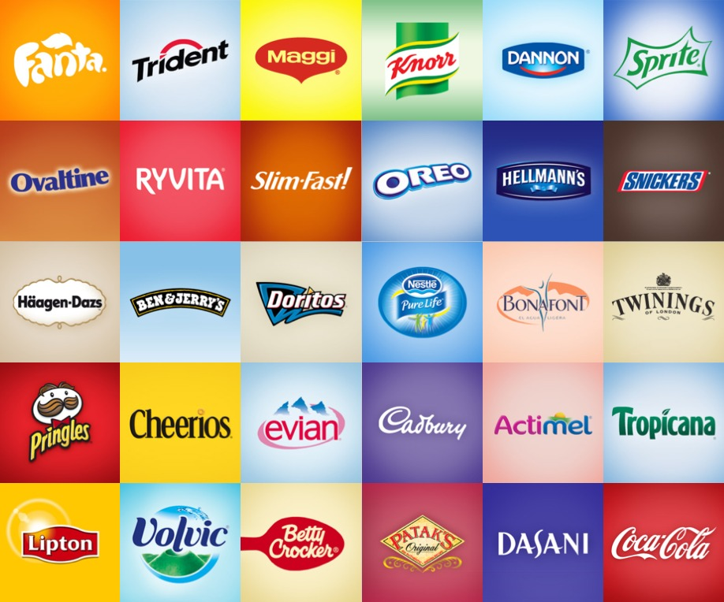

We deployed it as a docker container instance on a cloud.
A POST request API endpoint is created.
Food companies can send request parameters such as the id of the center and the response would be the predicted number of orders.
With the predicted number of orders at hand the inventory of the company can be planned accordingly.
Price of meal for this week? 100$.....
POST Request
Predicted number of orders= 300
Notes:
We plan to deploy using docker instance on a cloud.
A POST request endpoint has been created.
Food companies can now use this API, use fetch data by making Get requests by sending request parameters like if a particular meal was featured on the homepage, if an email was sent to promote it, etc. A response would be received which has the predicted number of orders.
This prediction would help the company to plan accordingly.

Slide 26
Future Enhancements
Notes:
Oishi

Slide 27
Model Architecture : Varying more hyperparameters, could be an useful thing to improve the model further. So instead of reducing the hyperparameters to avoid overfitting, we could vary dropout layers and weight decay.
Blending : We could try doing research by blending neural network with a lightGBM model.
Raw materials : Along with the prediction of the number of orders for the next week, we could also suggest what and how much raw materials are needed to satisfy that demand . And also keeping in mind the short perishability of certain food items and then evaluating the results accordingly would help in the future.
Modern businesses : we can take advantage of the model and solve tasks such as forecasting customer engagement, future trends, brand development, marketing campaigns, resources usage, etc.

Slide 28
References
The following are some of the references we used for building our project:
[1]We obtained the dataset from the following link:
https://www.kaggle.com/kannanaikkal/food-demand-forecasting
[2]A Towards Data Science Blog providing valuable suggestions for modelling
[3]Kilimci, Zeynep & Akyuz, A. & Uysal, Mitat & Akyokus, Selim & Uysal, Merve & Bulbul, Berna & Ekmis, Mehmet. (2019). An Improved Demand Forecasting Model Using Deep Learning Approach and Proposed Decision Integration Strategy for Supply Chain. Complexity. 2019. 1-15. 10.1155/2019/9067367.
[4]Paták, Michal & Vlckova, Vladimira. (2012). Demand Planning Specifics in Food Industry Enterprses. 1168-1175. 10.3846/bm.2012.150.

Slide 29
Cheers!

